Slide 1
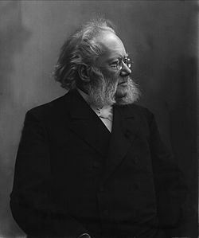
Henrik Ibsen
March 20, 1828 - May 23, 1906
His Life
His Beliefs
His Plays

Slide 2
Early Life
Born in 1828 in small town of Skien, Norway
Father had a successful merchant business
At age 8, family business failed
Family reduced to poverty

Slide 3
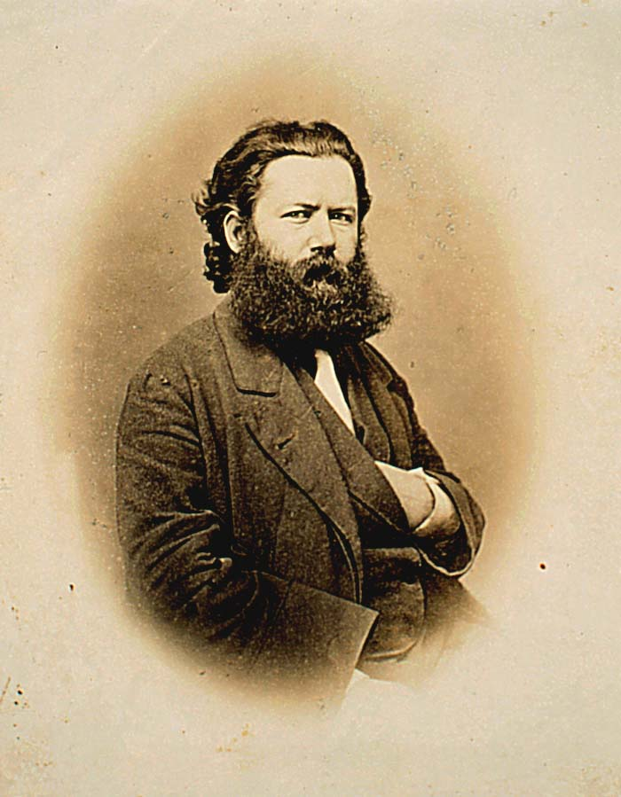
Early life
First job - age 15 - pharmacist’s apprentice
Family values
Aloofness
Independence
Ibsen resented being dependent on those in power

Slide 4
Norway
1848 - time of revolution - capitalism on the rise
Sweden seen as oppressive
Patriotic country
Viking past

Slide 5
Ibsen’s writing
Wrote about Vikings - Norwegian pride
Tends to protest capitalistic principles
Seen as a revolutionary
In 20s wrote Catiline
About a slandered rebel
First success for Ibsen

Slide 6
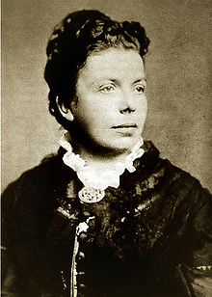
Ibsen’s Middle Years
1857 - became director of National Theatre in Christiania (Oslo)
1858 - married Suzannah Thoreson and later had a son
1862 - Wrote Love’s Comedy
Critiqued decadence of family life
Reputation as cynic and atheist

Slide 7
In Ibsen’s own words
“If I cannot be myself in what I write, then the whole is nothing but lies and humbug.”

Slide 8
Isolation
1864 - Ibsen left Norway due to disgust with the upper class
Lived in Italy and Germany
Stayed away from Norway for 27 years

Slide 9
Ibsen’s ideas
Felt that the middle class had power, but didn’t know how to use it
Necessary to recognize moral weaknesses in people to triumph over them

Slide 10
Famous plays
Brand (1865)
Peer Gynt (1867)
Ghosts (1881)
Wild Duck (1884)

Slide 11
Famous plays
A Doll’s House (1879)
Critical of roles in
marriage and family

Slide 12
Famous plays
An Enemy of the People(1882)
Controversy was primary Focus
Antagonist was entire community
One primary message of the play is that the individual, who stands alone, is more often "right" than the mass of people, who are portrayed as ignorant and sheep like.
Illustrated how people on both sides of the social spectrum could be equally self-serving.

Slide 13
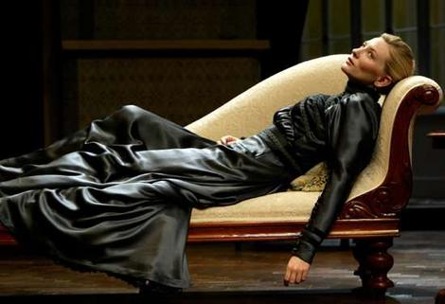
Famous plays
Hedda Gabler (1890)
Shallow woman
Lacks courage when
faced with scandal

Slide 14
Ibsen’s Formula
Ibsen perfected the well-made play formula; and by using a familiar formula made his plays, with a very shocking subject matter, acceptable. He discarded soliloquies, asides, etc..

Slide 15
Ibsen’s Formula (Continued)
Exposition in the plays was motivated, there were causally related scenes, inner psychological motivation was emphasized, the environment had an influence on characters’ personalities, and all the things characters did and all of things the characters used revealed their socio-economic milieu. He became a model for later realistic writers.

Slide 16
In Ibsen’s own words
“Before I write down one word, I have to have the character in my mind through and through. I must penetrate into the last wrinkle of his soul.”

Slide 17
Style
Realism
Said to have perfected the form of the social reform play
Symbolic plays

Slide 18
Themes
Moral and ethical relations of people
Self-realization
Self-annihilation
Suicide
Class struggle

Slide 19
In Ibsen’s own words
“It is inexcusable for scientists to torture animals; let them make their experiments on journalists and politicians.”
“The strongest man in the world is he who stands most alone.”

Slide 20
Ibsen’s last years and death
Suffered from several strokes during the last few years of his life
Died in 1906
In Christiania, Norway
Ibsen spluttered his last words which were "On the contrary"

Slide 21
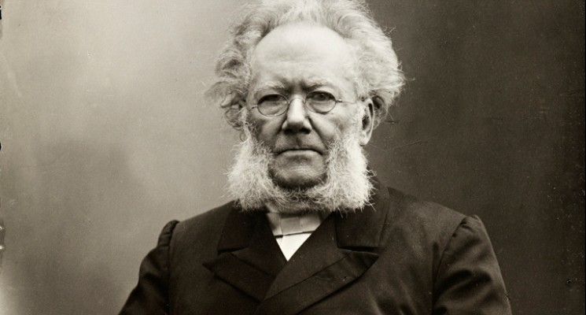
Henrik Ibsen
The Father of Modern Drama

Slide 22
Famous plays
A Doll’s House (1879)
Critical of roles in
marriage and family

Slide 23
Nora
Protagonist in A Doll’s House
Became a symbol in many countries for the changing role of women
How does Ibsen portray her?
Is she a heroine?
Is this play a feminist work??

Slide 24
In Ibsen’s own words
“A woman cannot be herself in the society of the present day, which is an exclusively masculine society, with laws framed by men and with a judicial system that judges feminine conduct from a masculine point of view.”

