Slide 1
William Shakespeare
His Life & Rhyme!

Slide 2
William Shakespeare

Slide 3
Mr. C’s Adventures
Stratford upon Avon!
Inside Shakespeare's House!

Slide 4
The Globe Theatre

Slide 5
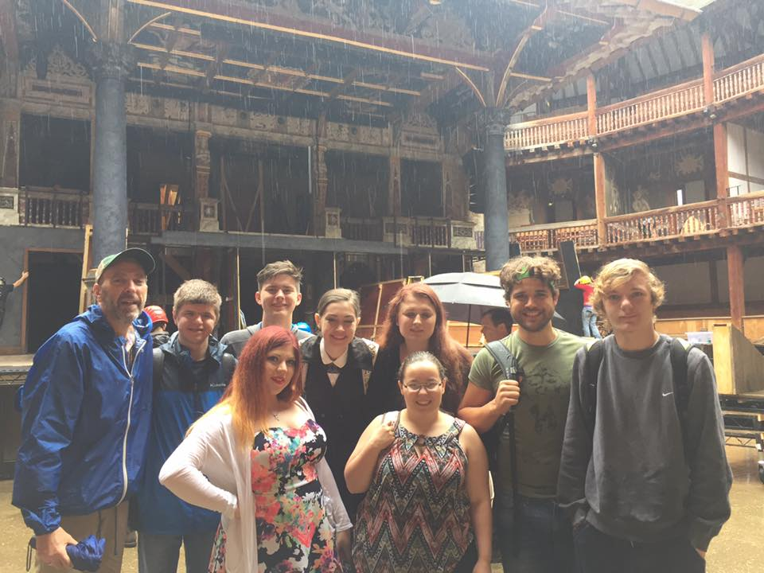
Inside the Globe!

Slide 6
Mr. C & Mr. Rose’s Secret Mission

Slide 7
Shakespeare’s Dating Tips

Slide 8
Verona, Italy
Juliet Statue/Balcony
But soft! What light through yonder window breaks?

Slide 9
Verona, Italy
Tomb of Juliet
It’s empty!

Slide 10
Shakespeare’s Rhyme

Slide 11
YOU & Shakespeare

