Slide 1
WELCOME TO FHS THEATRE I!
Mr. Trevor CooperESCUE

Slide 2
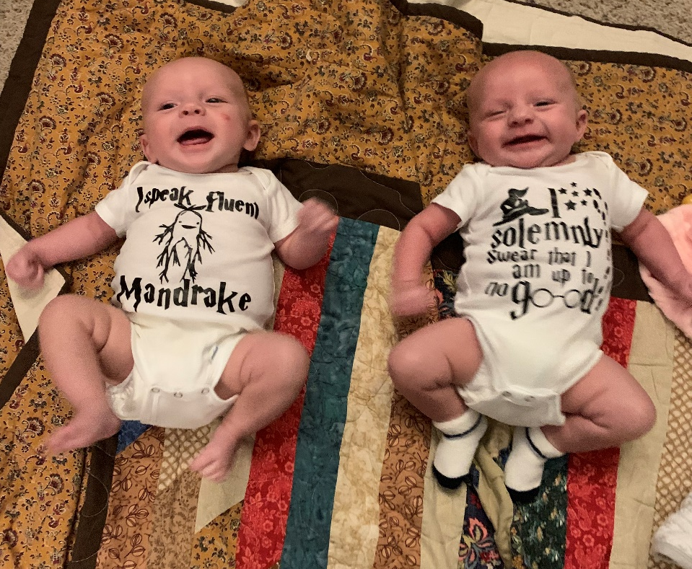
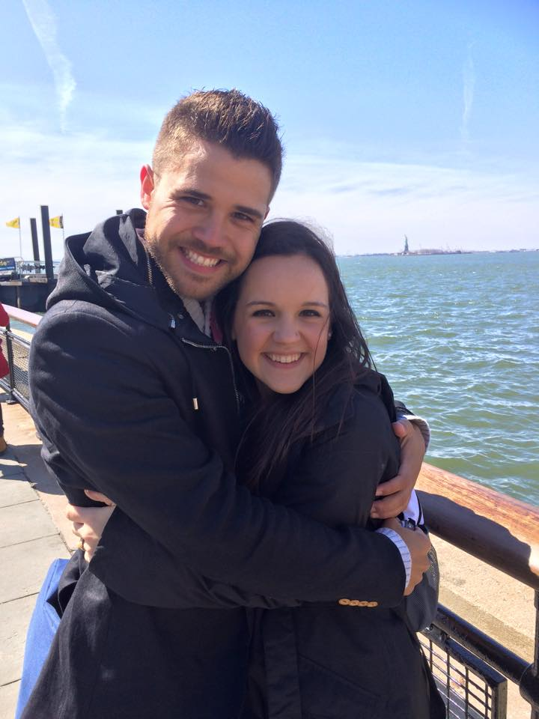
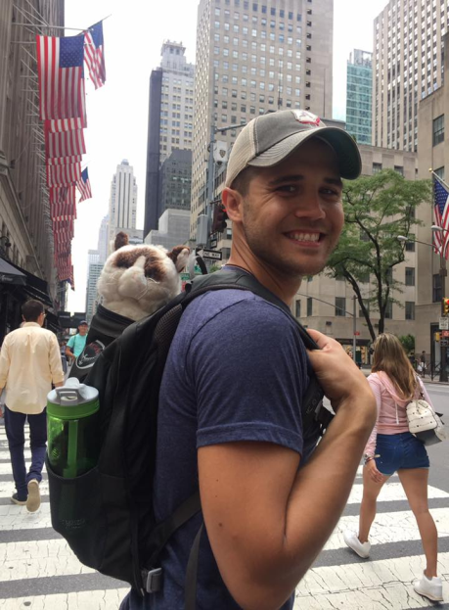
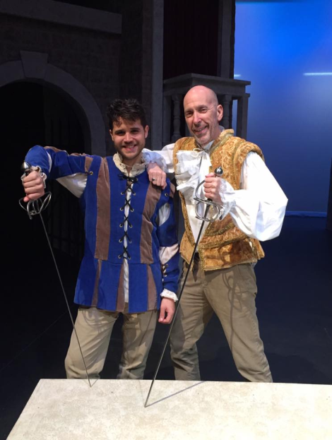
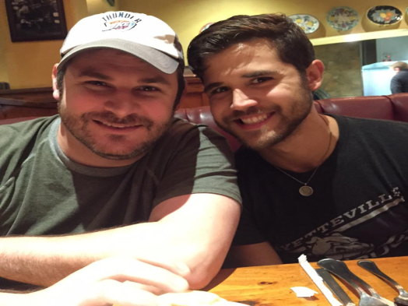
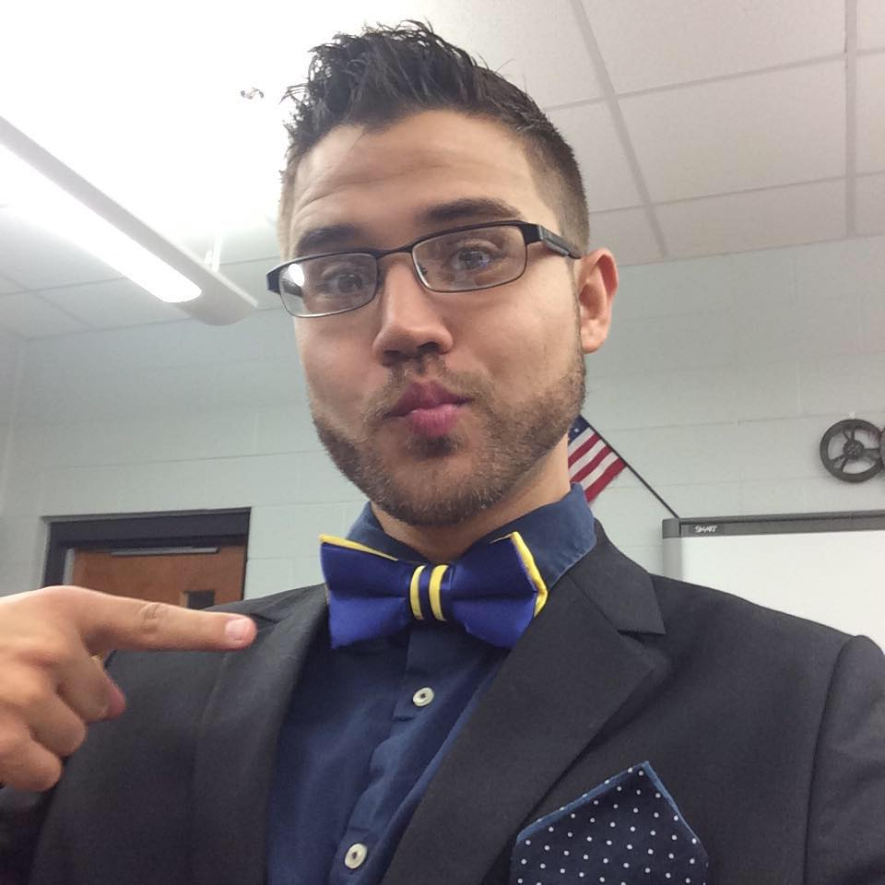
MEET MR. COOPERESCUE

Slide 3
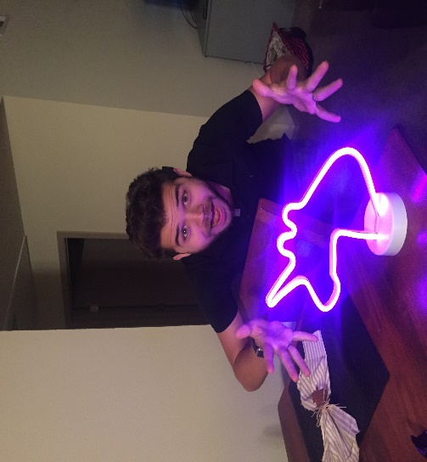
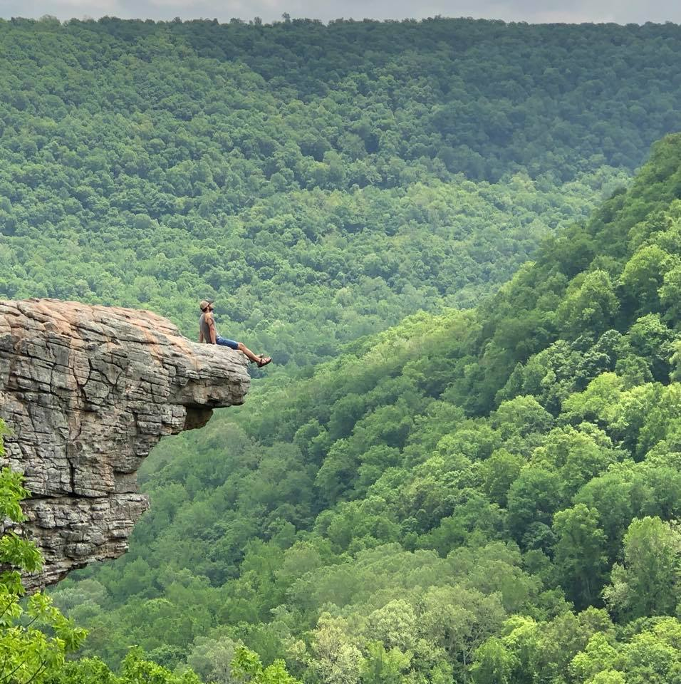
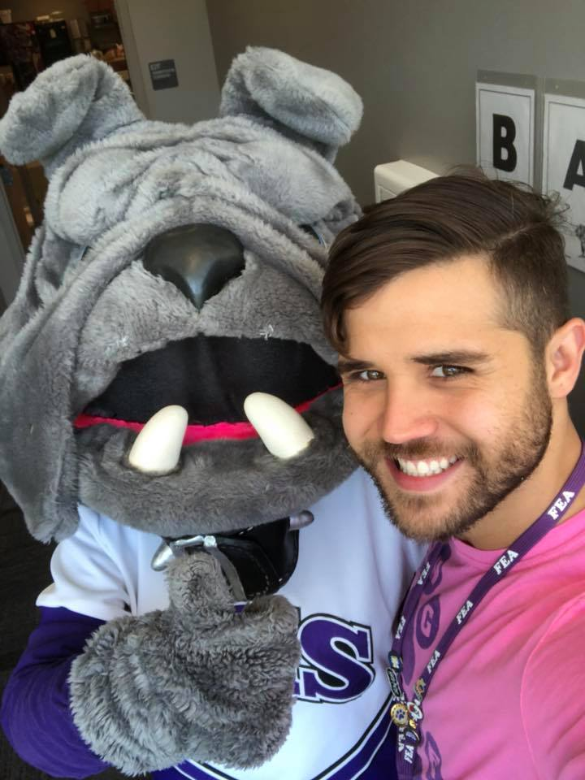
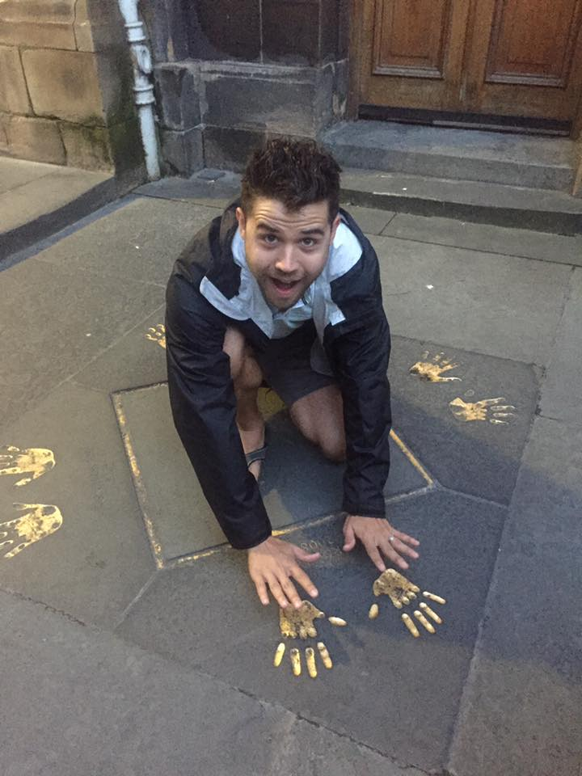
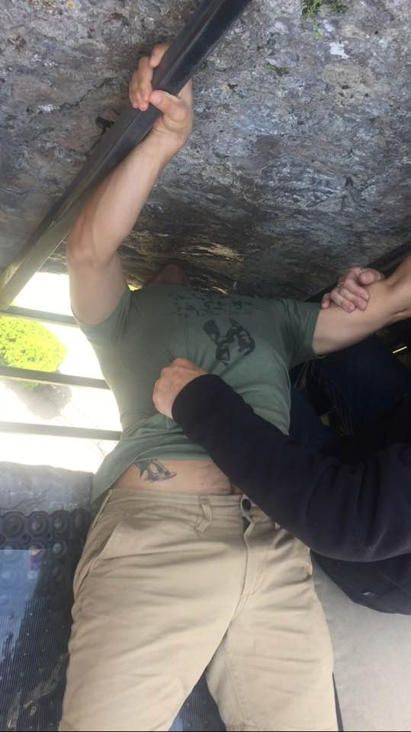
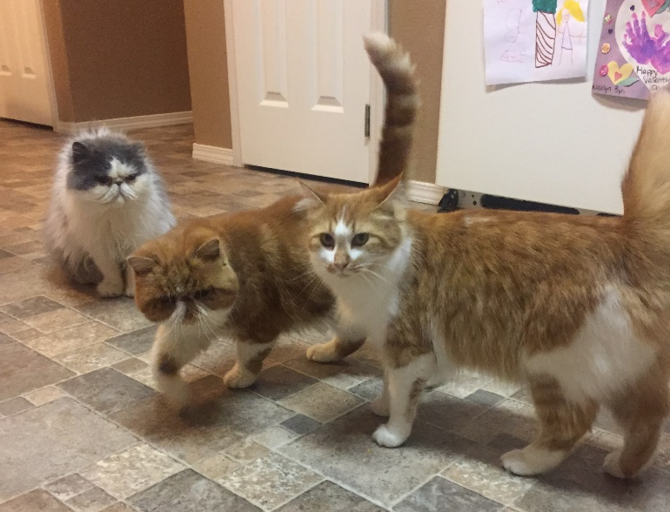
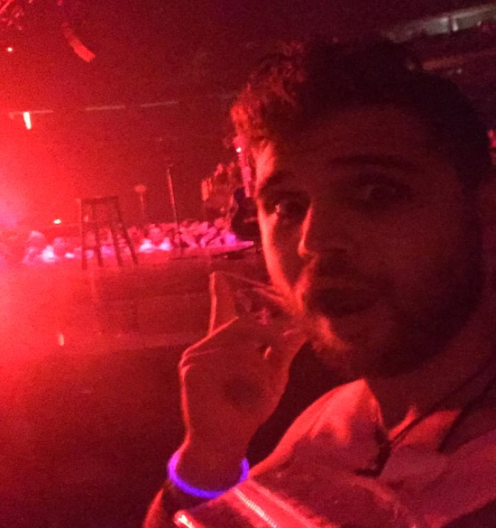

Slide 4
Why take THEATRE?
What do we do?
Assignments/Performances?

Slide 5
Theatre II Units

Slide 6
Type of Assignments?
*Improv
*History of Theatre
*Play/Text Analysis
*Character Analysis
*Monologue
*Scene Work
*Directing, Playwriting, Auditions
*Attend ALL FHS Theatre Productions

Slide 7
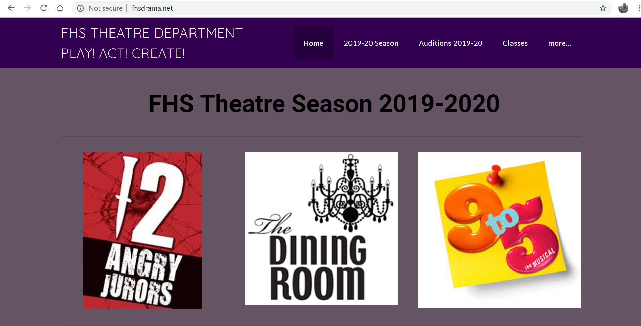

Slide 8
Important Dates!
August 22-23: 12 Angry Jurors Auditions 4:00-6:00 Black Box Theatre
August 27th: Shakespeare In Love: 9:20-12:40 Theatre Squared
October 24th-26th: 12 Angry Jurors Performances 7:00 Black Box Theatre
October 27th: 12 Angry Jurors Performance 2:00 Black Box Theatre
December 10th: Theatre II One Act Performance 12:40-1:20 Black Box/PAC
December 12th: Theatre II One Act Performance 12:40-1:20 Black Box/PAC
October: The Dining Room Auditions: TBD
November: 9 to 5 Auditions: TBD

Slide 9
Important Dates!
January 23rd: The Dining Room Performance 12:40-3:50 Black Box Theatre
January 24th-25th: The Dining Room Performances 7:00 Black Box Theatre
January 26th: The Dining Room Performance 2:00 Black Box Theatre
February 11th: Thespian Induction/Dessert Theatre 5:30 Black Box Theatre
February 13th-15th: Thespian Festival in Jonesboro, AR (Must be inducted to attend)
March 16th: Theatre I One Act Performance 12:40-1:20 Black Box/PAC
March 18th: Theatre I One Act Performance 12:40-1:20 Black Box/PAC
April 15th-17th: 9 to 5 Performances 7:00 PAC
May 5th: Theatre Awards/Thespian Inductions 5:30 Black Box Theatre

Slide 10
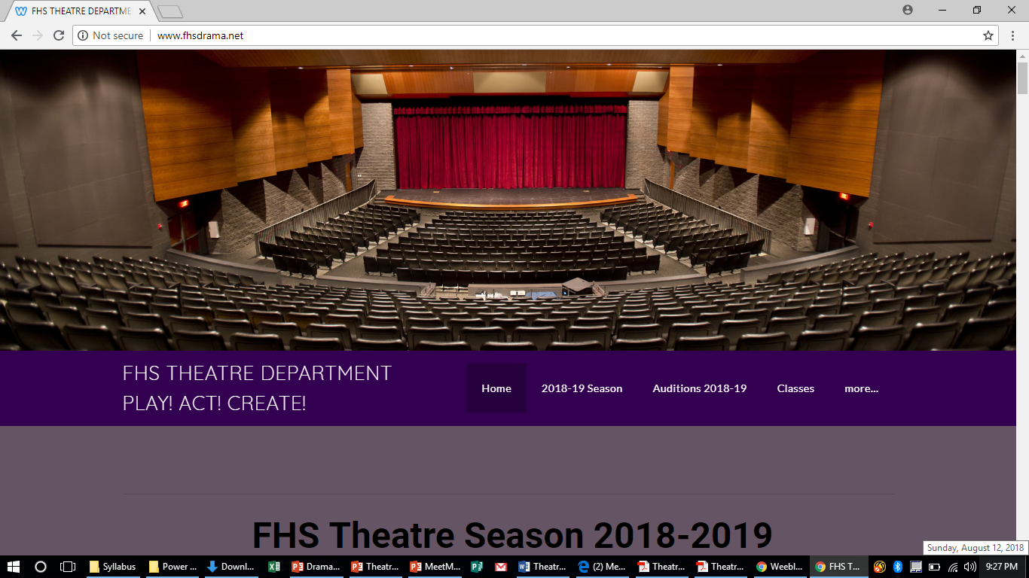
FOLLOW US ONLINE!
ALL INFORMATION WILL BE ON OUR CLASS WEBSITE!
http://www.fhsdrama.net

Slide 11
What do you need?
+
OR
+
+
=

Slide 12
We use REMIND!
Text @fhsdrama1 to 81010

Slide 13
QUESTIONS?
Email: trevor.cooperescue@fayar.net
Phone Number: 479-445-1334

Slide 15
The Second City’s Improv in the classroom! By Dr. Katherine S. McKnight

Slide 16
ENERGY BALL!

Slide 18
SWOOSH!
GA GONG!

